Slide 1
ML Final project
Group №20 «Asphalt 8»
Esipova Anna 212
Khorova Anna 211
Gaverdovskaya Polina 212

Slide 2

We did the project and all its tasks together

Slide 3
In our project, we trained a machine learning model so that it could determine the value of a flat based on certain data.
After sorting through the data, we decided to take the following important items for flats:
1. Number of rooms
2. Parking
3. Value
4. Region
5. House Name
6. Number of freight lifts
7. Balcony/Loft
8. House Type
9. Number of shower units
10. Renovation
11. Distance to the underground

Slide 4
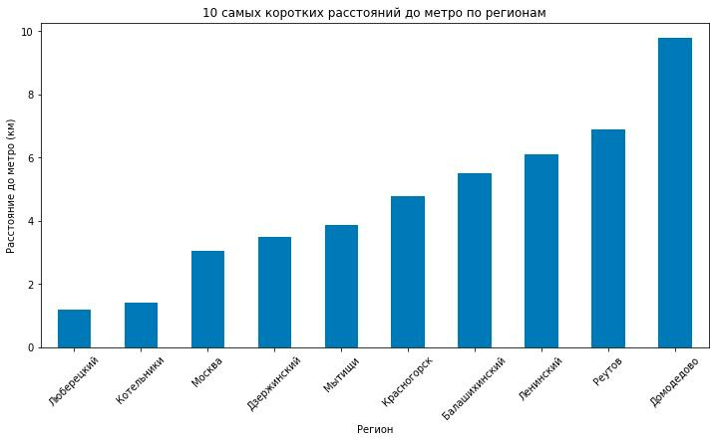
First Diagram
The first graph shows the correlation between metro distance and region
The graph shows the 10 shortest distances from the entire list
What is unusual about the correlation is that Moscow, as the capital, does not have the shortest distances to the metro. It is only in third place, after the regions of the Moscow region

Slide 5
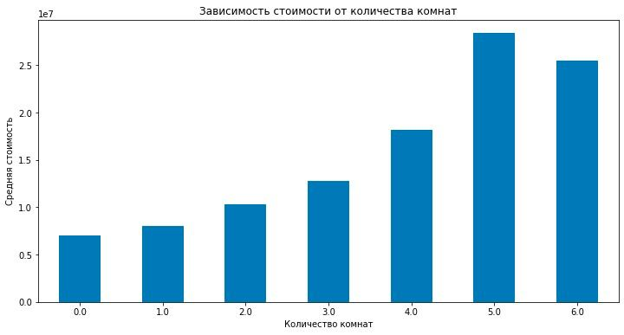
Second Diagram
Our second diagram shows the dependence on cost and number of rooms
We found this relationship interesting because it is often the case that a 5-bedroom flat costs less than a 6-bedroom flat, and our diagram proves it

Slide 6
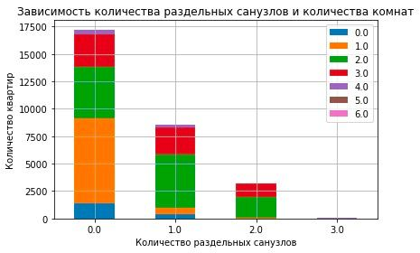
Third Diagram
The graph shows the relationship between the number of rooms in a flat and the number of separate bathrooms.
The graph shows a decreasing trend when most flats have one or zero separate bathrooms, while the number of flats with two or more separate bathrooms decreases

Slide 7
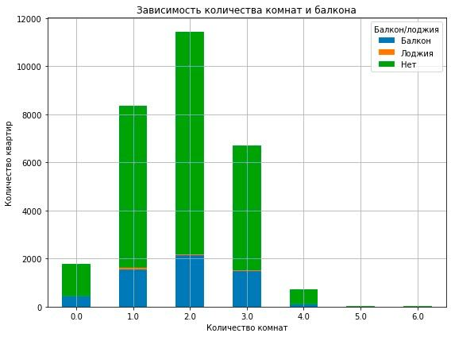
Forth Diagram
The fourth diagram shows the relationship between the number of rooms and the presence of a balcony
We were interested in this relationship because small flats rarely have a balcony or loggia
In our diagram we can see that a 1-bedroom flat has a balcony more often than a studio flat and a 2-bedroom flat

Slide 8
description of models
KNN
K-nearest neighbors algorithm
RandomForest

Slide 9
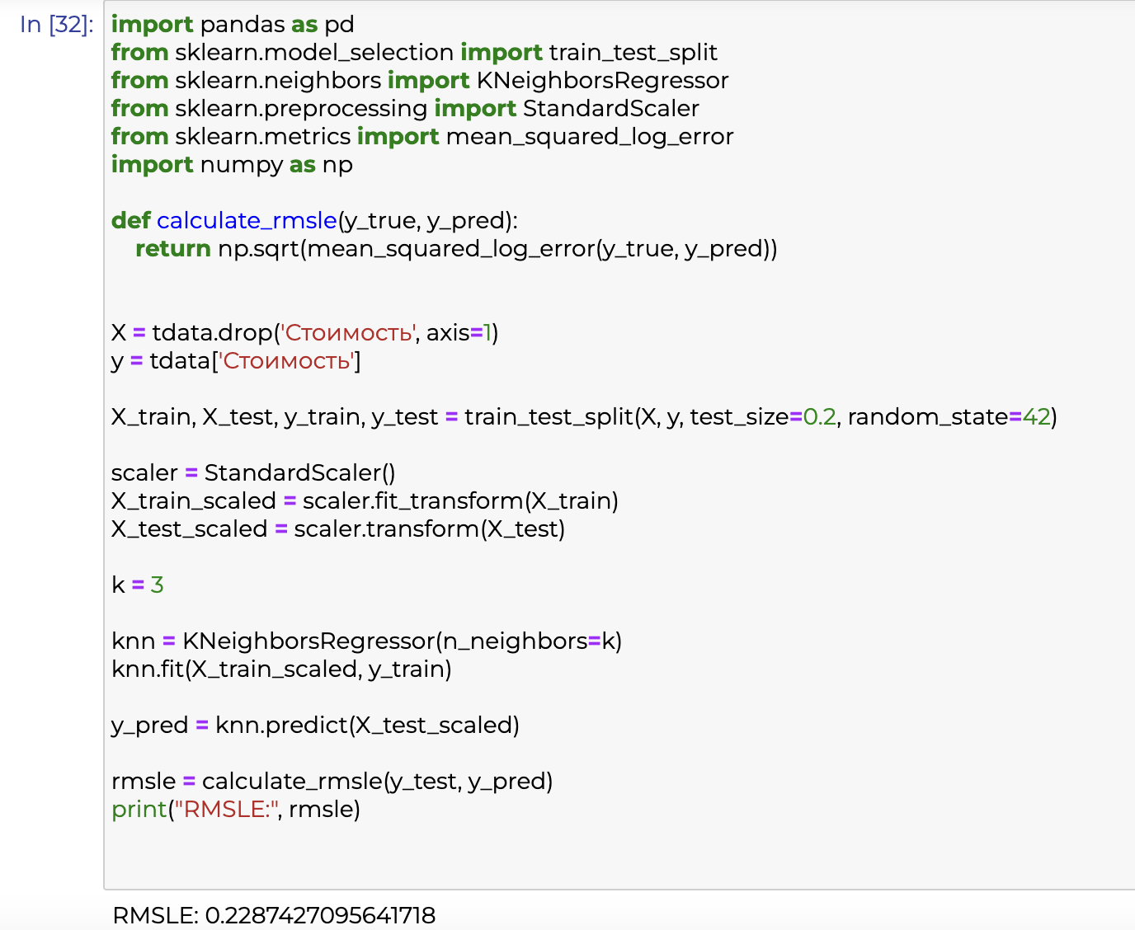
KNN
K-nearest neighbors algorithm

Slide 10
Best solution

Slide 11
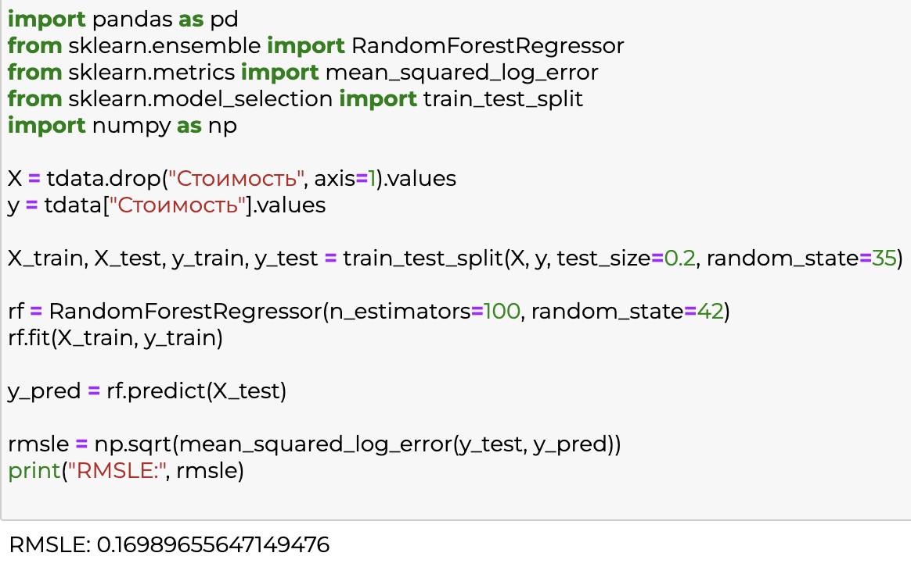
RandomForest

Slide 12
Thanks for your attention
мы старались, поставьте 5

